Slide 1
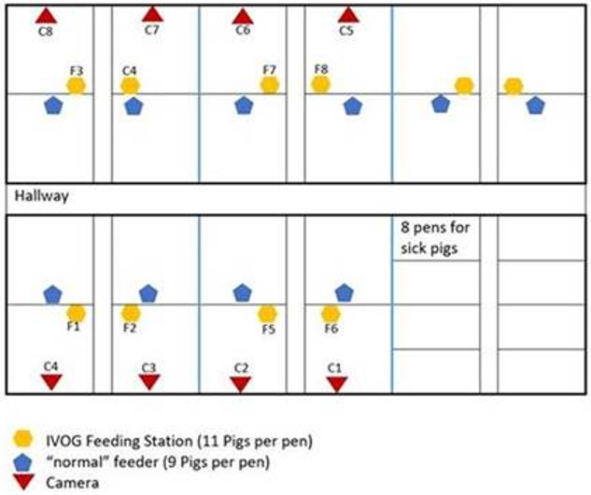
Compartment, pen, camera and feeding station numbers
3
4
7
8
9
10
Entrance
2
4
5
1
3
2
1
6
5
C3
Experiment 1
Notes:
On 19-01-2021, camera C3 has been moved from pen 2 to pen 1 because of an ongoing tail biting outbreak.

Slide 2
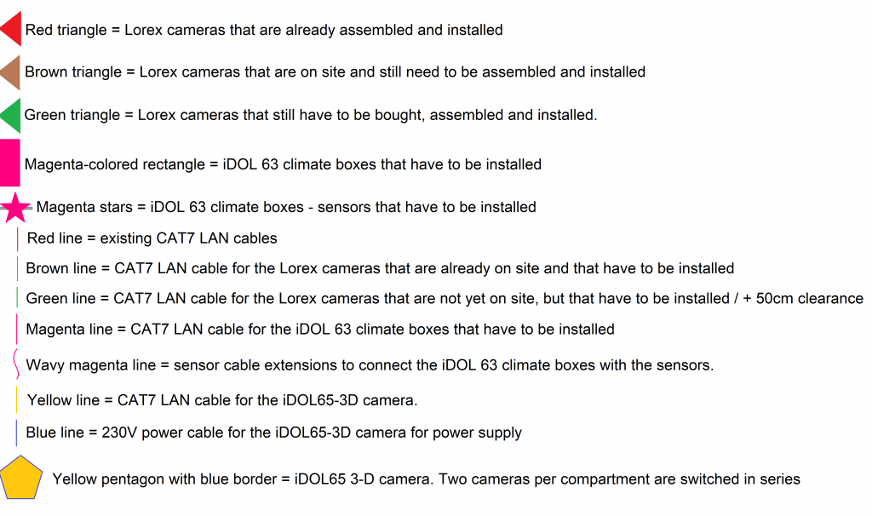
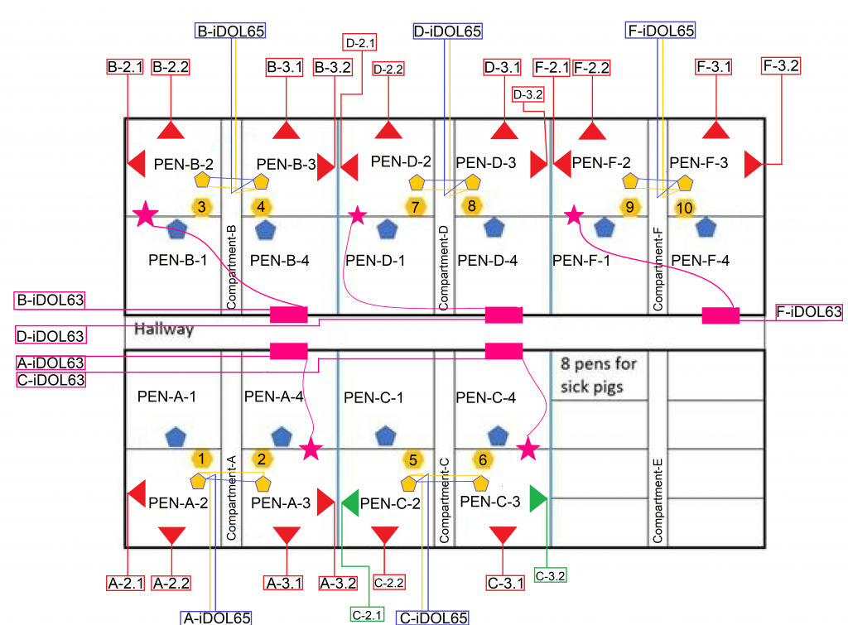
Experiment 2-4
More cameras, and added 3D cameras and climate sensors.

Slide 3
Compartment, pen, camera and feeding station numbers
2
3
2
3
2
3
B1
4
1
4
1
4
2
4
5
1
3
1
4
1
4
2
3
2
3
As used by Topigs in
C3
Experiment 1
Notes:
Compartment numbers 1,2,3,4,5 correspond to A,B,C,D,F (sick bay = E, and doesn’t have a number here)
On 19-01-2021, camera C3 has been moved from pen 2 (A2) to pen 4 (A3) because of an ongoing tail-biting outbreak in pen A3.

